Slide 1


Unique identifiers
for training materials
Module 8 – FAIR Training Material by Design
October 21-22, 2025
Ineke Luijten, PhD
Adjusted from Elin Kronander, PhD
Notes:
Title: "Unique identifiers for training materials"
Slides author:
name: "Ineke Luijten"
ORCID: 0000-0001-5768-275X
email: ineke.luijten@scilifelab.se
Adjusted from:
name: "Elin Kronander"
ORCID: 0000-0003-0280-6318
email: elin.kronander@scilifelab.se
Part of: FAIR Training Material by Design
Url: https://elixir-europe-training.github.io/ELIXIR-TrP-FAIR-Material-By-Design/latest/
duration: 105 min

Slide 2
Learning outcomes
Explain what unique persistent identifiers are and their benefits
List and differentiate the types of unique identifiers that are relevant for publishing and sharing training materials
Compare different strategies for unique identifiers for training materials
Create versioned DOIs for training materials
Notes:
This session is divided in 2 parts:
Part 1, will be more theoretical and cover what unique identifiers are and how they can be used for training materials. We will see some real world examples and discuss different strategies.
What is a unique identifier?
Why are they useful for training materials?
Explore different strategies for adding them to training materials
Part 2, will be more practical where you will use the public repository Zenodo to assign a digital object identifier to your github repo or if you have used Google drive there will be an option for that as well
Use Zenodo to assign a DOI to training materials
Use releases in GitHub to make versioned DOIs

Slide 3





What is a unique persistent identifier?
Identify
Verify
Locate
Notes:
So to start with — what exactly is a persistent identifier?
A PID is a long-lasting reference that uniquely tags a resource, such as a dataset or publication. It provides all the information needed to reliably identify, verify, and locate that resource — eliminating many misunderstandings that can occur when web links change or break.
PIDs can also be connected to a set of metadata that describes the resource, not necessarily the item itself.
The key idea is persistence: even if the location or URL of your dataset changes, the PID remains the same, and a central registry will redirect users to the current location.
In other words, PIDs help us avoid broken links and ensure that research outputs stay findable and accessible over time.
To make this more concrete, let’s look at an example…

Slide 4






An example:
JANE
JANE SMITH, CASHEW WAY
GERMANY
JANE DOE, MILL RD 1 SWEDEN
JANE DOE, HIGH ST 5
NORWAY
Notes:
Imagine you’re invited to a high school reunion in your old hometown. Over the years, you’ve moved several times and maybe even changed your name — so if someone tries to send you an invitation, it might never reach you.
Now, imagine you had a magical mailbox that never changes. You could give people this address once, and no matter where you live — or what your name is — letters would always find you.
That’s exactly what a Persistent Identifier, or PID, does for digital information.
A research paper, dataset, or training video might move to a new database, or its URL might change — but the PID stays the same and always points to the right place.
The purpose of a PID is to reliably identify, verify, and locate a resource.
In order for this to work, PIDs must follow a few important rules — which we’ll look at next.

Slide 5
Features of PIDs
Globally unique
It should comply with a controlled syntax to avoid clashes
Persistent
It should be maintained for a long period of time. The syntax used for the identifier should also be persistent
Resolvable
It should allow both human and machine users to access the resource
Notes:
So, for a PID to really work as that “magical mailbox,” it has to follow a few key rules.
It has to be globally unique. This means that every PID must be different from every other one in the world. To make sure of that, identifiers follow a controlled syntax, often using namespaces that are managed by clearly defined authorities. That way, no two PIDs ever point to different objects by mistake.
It must be persistent. Both the identifier and the object it points to should be maintained over time. Persistence includes both the technical structure (the PID syntax should not change) and organisational commitment (a registry or authority must ensure continued resolution and management). Even if the object’s web address changes, the PID should always lead you to the current location. This prevents broken links and helps ensure that research outputs remain accessible long after they’re published.
It must be resolvable. That means that when someone, or a machine, clicks on or looks up the PID, it should actually lead somewhere: either to the resource itself or to information about it.
So, uniqueness, persistence, and resolvability are the three core features that make PIDs reliable, long-lasting, and useful for FAIR data and training materials.

Slide 6

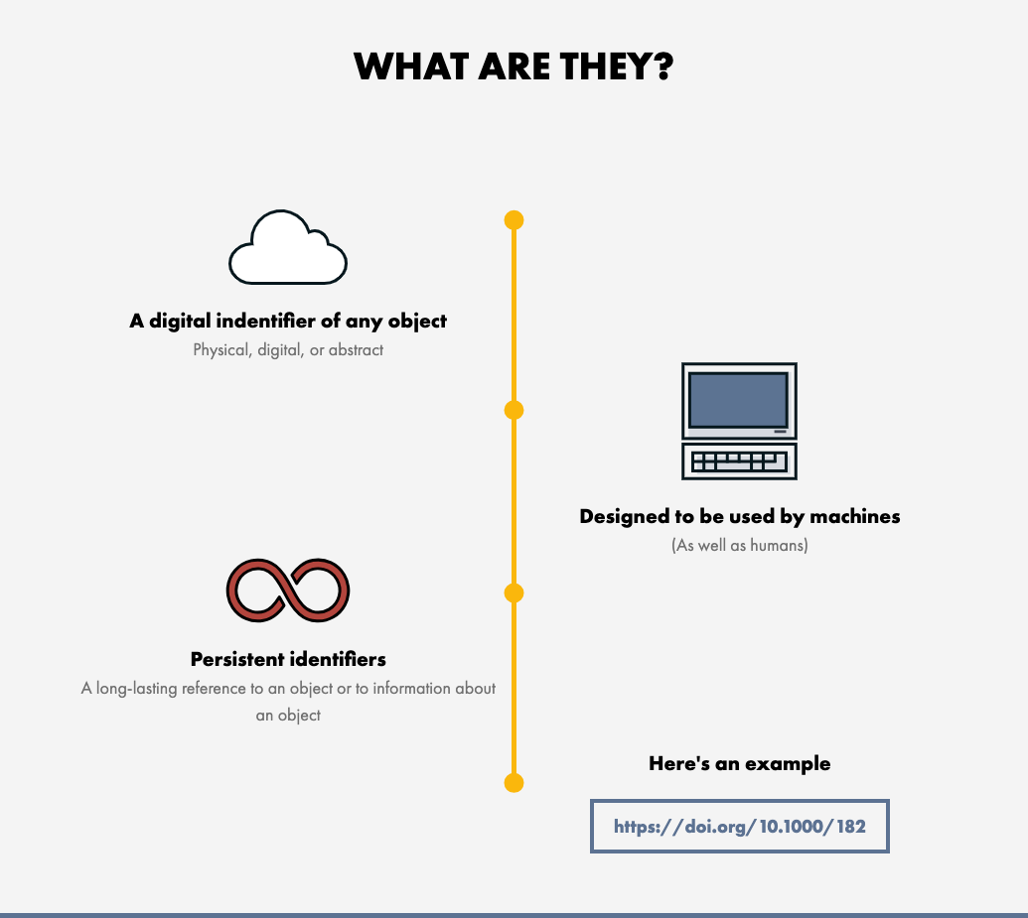
Digital object identifier - DOI
Illustration from the DOI Foundations website https://www.doi.org/the-identifier/what-is-a-doi/
Notes:
One of the most familiar examples of a persistent identifier is the DOI, the Digital Object Identifier. You’ve probably seen one before, for example in a journal article reference or a dataset citation.
The DOI system is one of the most widely used PID systems, especially in scholarly publishing and public data repositories.
Like all persistent identifiers, a DOI is a long-lasting reference that uniquely tags a resource. Even though the identifier itself is digital, the thing it identifies can be anything, for example a physical object, a digital file, or even an abstract concept like a dataset version or a model.
DOIs are actionable, which means you can type them into a web browser, or example https://doi.org/10.1000/18, and it will take you to a landing page describing the object and its metadata. Sometimes that page also gives you access to the object itself, but not always. Sometimes the DOI only links to descriptive metadata rather than the content, especially if access is restricted.
One of the strengths of the DOI system is that it connects each identifier to a metadata record that can be updated over time. That means even if a paper or dataset moves to a different location, the DOI still resolves correctly because the metadata is maintained by the registration agency.
Technically, a DOI is made up of two parts: a prefix and a suffix, separated by a forward slash. The prefix identifies the organisation or publisher that registered the DOI, and the suffix identifies the specific item. For example, in 10.1000/182, “10.1000” is the prefix, and “182” is the suffix.
The DOI system itself is governed by the International DOI Foundation, which coordinates a network of Registration Agencies (e.g DataCite, Crossref, mEDRA) each serving specific communities. These agencies assign DOI prefixes, manage metadata, and ensure that DOIs remain resolvable and persistent over time.
How does this work?

Slide 7
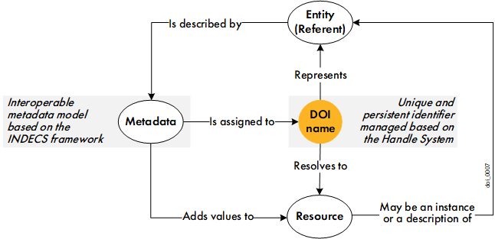
Digital object identifier - DOI
Illustration from The DOI Handbook April 2023 (https://doi.org/10.1000/182 identifies the latest current version of the handbook)
Notes:
This figure illustrates the basic principle of how the DOI System works.
Let’s start in the middle.
Any entity (digital, physical, or abstract) can be assigned a globally unique and persistent identifier called a DOI name. Each DOI name can be resolved, i.e. when you use it in a web browser or through an API, it will direct you to a resource that provides information about the entity. That resource is often a landing page, e.g. a record in Zenodo, a journal publisher’s webpage, or another repository. It includes metadata describing the object and, when possible, links to the actual content. In some cases, the DOI may resolve directly to the digital object itself, e.g. a DOI representing an article might take you to the HTML version of the paper.
Every DOI must have metadata assigned to it. This metadata describes the object the DOI represents, and includes its title, creators, publication date, and publisher. It ensures that the object can be identified, cited, and located reliably. To ensure that this metadata can be used across different systems and repositories, the DOI Foundation defines a set of interoperability principles and metadata standards that all DOI registration agencies must follow. Metadata not only enriches the landing page for human users by providing context and citation details, but also allows machines to search, discover, and connect related resources through their DOIs.
In short, the DOI system links a persistent, unique identifier with standardised metadata and a resolvable landing page, ensuring that research objects can always be found, cited, and reused, no matter where they live on the web.

Slide 8
Benefits of DOIs
Uniquely distinguish resources from similar objects (F)
Provides a place to store and manage metadata (F)
Machine-actionable identifiers improve searchability and findability (F)
Resolves to a landing page that provides info or access to the resource (A)
Enhances citability, attribution, and long-term reuse of the resource (R)
Notes:
The benefits of using unique identifiers are several:
F – Findable
DOIs make your resources uniquely identifiable, preventing confusion between similar objects. They also provide a structured place to store metadata, which can be read by both humans and machines. Because DOIs are machine-actionable, they improve discoverability and make your materials easier to find through search engines or automated systems.
A – Accessible
Each DOI resolves to a landing page or resource record, giving users clear information on how to access the object. Even if the location of the actual content changes, the DOI ensures that users can always reach the metadata or the object itself.
I – Interoperable
While DOIs themselves do not automatically make a resource interoperable, the standardized metadata schemas (e.g., DataCite metadata) associated with DOIs allow data and information to be shared and understood across systems.
R – Reusable
DOIs enhance citability, making it easier for others to reference your work accurately. Proper citation and persistent tracking of outputs help acknowledge creators, promote reuse, and ensure that materials remain usable over time.

Slide 9


Other important PIDs
ORCID - Open Researcher and Contributor ID
Persistent identifiers for individual researchers
Solves name ambiguity (handles homonyms)
Allows aliases if your name changes
Remains the same when affiliation changes
Notes:
ORCID stands for Open Researcher and Contributor ID. It’s a global, non-profit organisation that provides unique, persistent identifiers to researchers, free of charge.
ORCID helps solve a very common problem in research: name ambiguity. Many researchers share similar or identical names, and ORCID makes sure your work is correctly attributed to you, not someone else.
Each researcher gets a unique 16-digit identifier, which stays the same throughout your career, no matter how often you change institutions, countries, or even research fields.
ORCID also takes name changes into account. If your name changes, you can add aliases or previous names to your profile so that all your publications and outputs remain connected to you.
Because your ORCID is persistent and portable, it helps ensure that you always receive proper credit for your contributions and that others can reliably find and verify your work, even years later.
Many publishers, funders, and repositories now require or strongly encourage researchers to include their ORCID when submitting papers, datasets, or grant applications, precisely for these reasons.

Slide 10

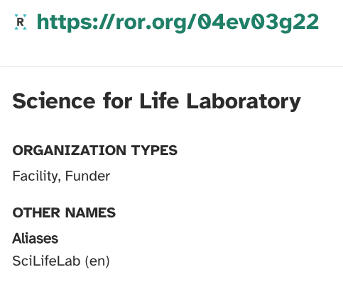
Other important PIDs
ROR - The Research Organization Registry
Persistent identifiers for research organizations
Disambiguates institution names and connections
Open, community-led global registry
Notes:
ROR, which stands for the Research Organization Registry, is a global, community-led initiative that provides open, persistent identifiers for research organizations. Some funders are now also using it instead of funder IDs.
Just like ORCID helps uniquely identify researchers, ROR helps uniquely identify institutions such as universities, research institutes, or laboratories.
This makes it much easier for people and systems to disambiguate organization names and to accurately connect research outputs, people, and grants to the correct institution.
For example, Science for Life Laboratory is often referred to simply as SciLifeLab. If you’re not familiar with the organization, it might seem like these are two different entities. However, by using the SciLifeLab ROR ID, it’s immediately clear that both names refer to the same organization.
ROR identifiers are open, free to use, and interoperable with other PIDs like ORCID and DOI, creating a consistent way to link researchers, organizations, and outputs across the research ecosystem.

Slide 11

Persistent identifiers
Reflect
In the context of training materials, why are PIDs needed? Which identifier would you use for each purpose?
Notes:
Depending on time and accessibility needs, ask participants to discuss with a neighbour or in plenary.
Some guidance for discussion:
To distinguish different training materials → use a DOI
To distinguish different versions of the same material → use a DOI
To distinguish different authors or contributors → use an ORCID
To distinguish different organisations → use a ROR
Encourage participants to think about how these identifiers make materials findable, citable, and reusable, and why linking them together supports FAIR principles.

Slide 12

DOI strategies for courses
Group discussion 10 minutes
Assign 1 person to take notes in the shared document under session 8.3
Read through the use case assigned to your group from the FAIR training handbook
Discuss and write down a short summary of the strategy used as well as pros and cons with this strategy
Plenary discussion 10 minutes
Each group will share their observations and reflections
Notes:
Execution:
- Divide students in 3 groups (or more if needed)
- Assign each group a use case
- Group discussions for 10 minutes
- Plenary discussion for 10 minutes (more time will be needed if you have more groups but if there are 2 groups with the same use case group 1 can summarize the strategy and group 2 can share their pros and cons, then group 1 can be invited to add any additional pros and cons they discussed)
Instructions to students:
You will discuss one use case per group and then share this with the rest of the groups.
- Assign someone to take notes in the shared document
- Read the use case and discuss benefits and drawbacks of the strategy used in your use case
- Write down short summary of the strategy and the pros and
Preparations:
- In the collaborative notes document: Link to the use cases, sections for each group to write in

Slide 13


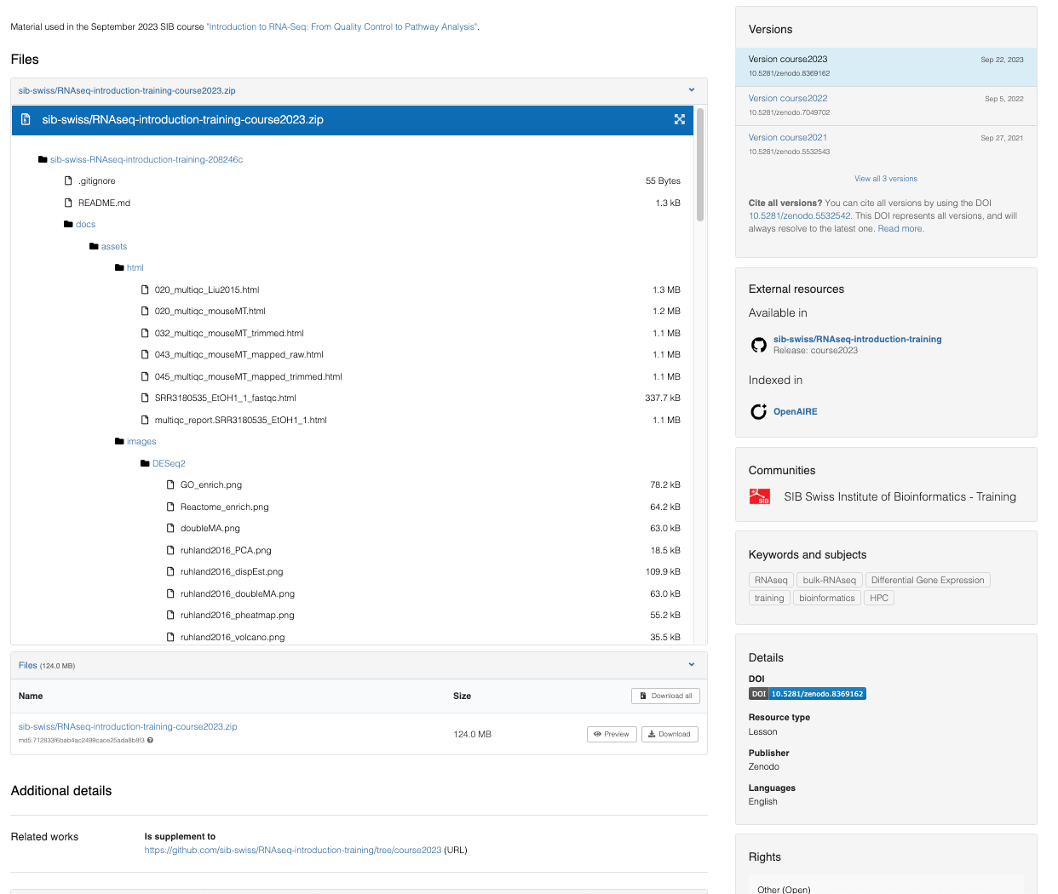
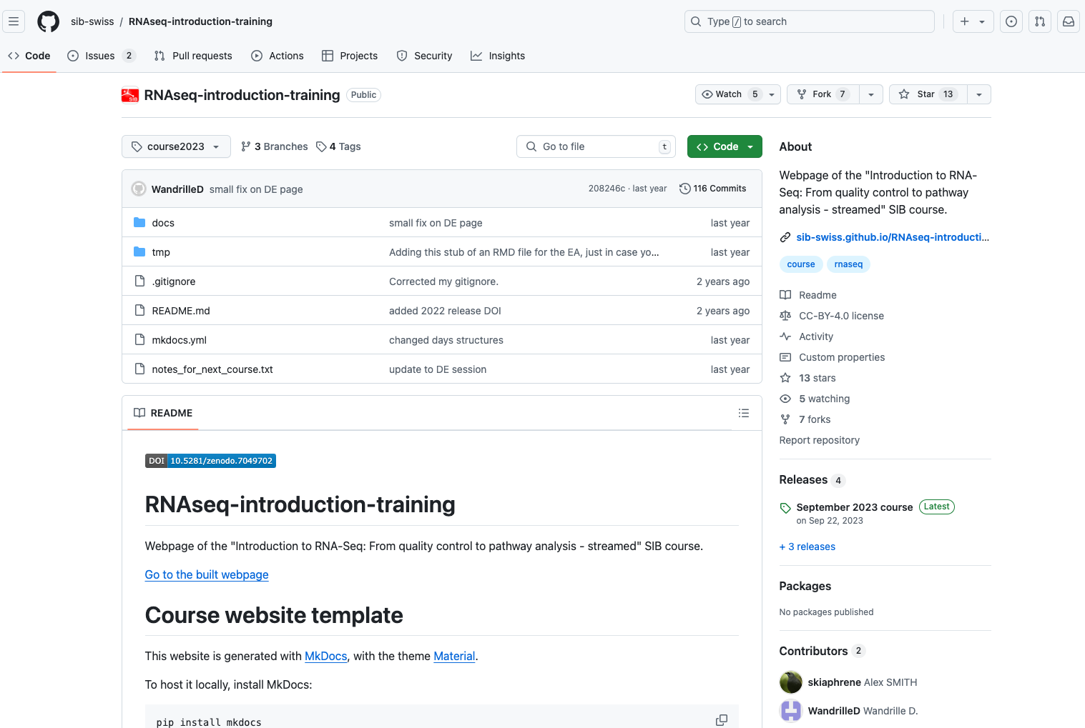
DOI strategies for GitHub repositories
10.5281/zenodo.5532542
Notes:
In the case studies you’ve seen examples of different strategies to utilize the public repository Zenodo to assign DOIs to training materials. That is one way of doing it. In this course we have promoted the use of GitHub for hosting markdown based training material. The public repositories Zenodo and Figshare have integrations with GitHub set up in order to issue DOIs for repositories. GitHub repository: https://github.com/sib-swiss/RNAseq-introduction-training
Zenodo Record: https://zenodo.org/doi/10.5281/zenodo.5532542

Slide 14
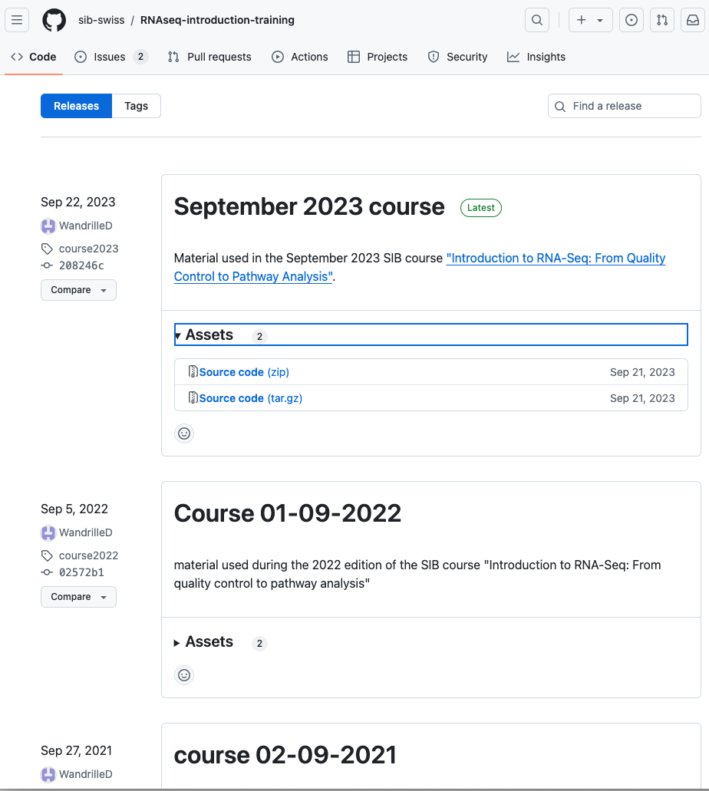
DOI strategies for GitHub repositories: releases
Snapshot of project at specific time point
Packaged with re-use in mind
Downloadable (zip file and tarball)
Attached with version number/name via a tag
Release notes to describe the specifics of the snapshot
Notes:
These integrations make use of GitHub releases which can be described as a snapshot of your project at a specific point in time that is packaged in way that make the content of the repository available for a wider audience to download and use. Each release is usually attached with a version number or name and attached to the snapshot in GitHub via a tag. This number/name helps users and authors keep track of different stages of the project and understand the differences between multiple releases. Releases can also be coupled with a title and release notes where the details of the specific release can be described. This will allow someone looking for a specific feature to find out what changes have been made without downloading and extracting the entire repository.
GitHub documentation on releases: https://docs.github.com/en/repositories/releasing-projects-on-github/about-releases
Github repository: https://github.com/sib-swiss/RNAseq-introduction-training/releases

Slide 15
DOI strategies for GitHub repositories: releases
Notes:
Since the integration between GitHub and Zenodo make use of releases, a new DOI will be created for each new release of the connected repository. These DOIs are linked and there will be 1 DOI representing all versions that will always resolve to the latest one. Each version also has their own unique DOI.

Slide 16
DOI strategies
Reflect
What could a good DOI strategy look like for your own context?
Do you want to assign a DOI to each individual training material, such as a video, slide deck, or document?
Would it be more useful to have one DOI for the entire course or training package?
If your course is divided into multiple topics or modules, would you prefer to assign a separate PID to each of them?
Or would you rather create a collection PID that represents the whole course, while still assigning individual PIDs (and metadata) to each topic or component within it?
Notes:
Individual reflection that might be left as an “after the course homework” depending on time. If this is taught in a context where several people are from the same team or organisation it might be useful to do this as a group discussion.

Slide 17

Tutorial
Get a DOI for your training material
Use Zenodo Sandbox to get a DOI for your training material
By using GitHub integration
By manually uploading a zip file of your GDrive folder
Enrich the Zenodo record with the metadata from previous session
Add the DOI to your hosting platform
Add the DOI to your TeSS record
Go to the tutorial in Chapter 08
Notes:
See https://elixir-europe-training.github.io/ELIXIR-TrP-FAIR-Material-By-Design/chapters/chapter_08/#83-tutorial-for-implementing-your-strategy-50-min

Slide 18

You now have FAIR
training material!

